Slide 1
The Saviors
We protect you.

Slide 2
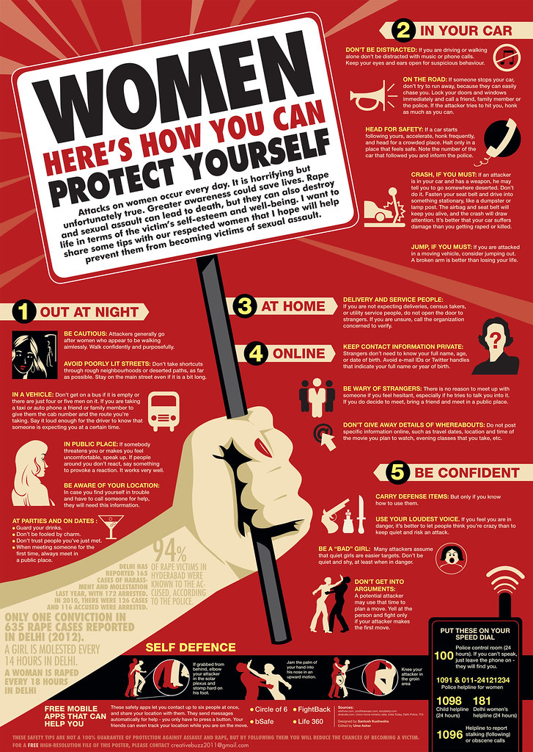

WOMEN SECURITY

Slide 3
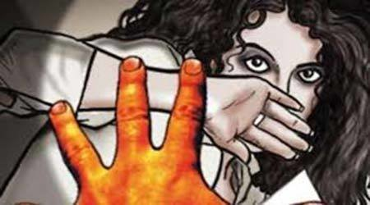
Problem statement
Day by day the women are facing many problems. They are insecure. Though many security applications have developed nothing stopped their insecurities nothing protected them. Every single day the count is increasing.

Slide 4
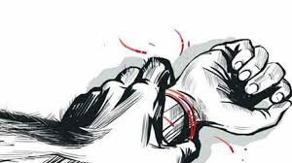
Abstract
We have came out with this project to make the women feel secured. When they step out of their home and travelling or walking alone a street when they feel insecure or something worse is happening. If they are unable to protect themselves. We are going to involve and access the present location of the victim and take steps to protect her.

Slide 5
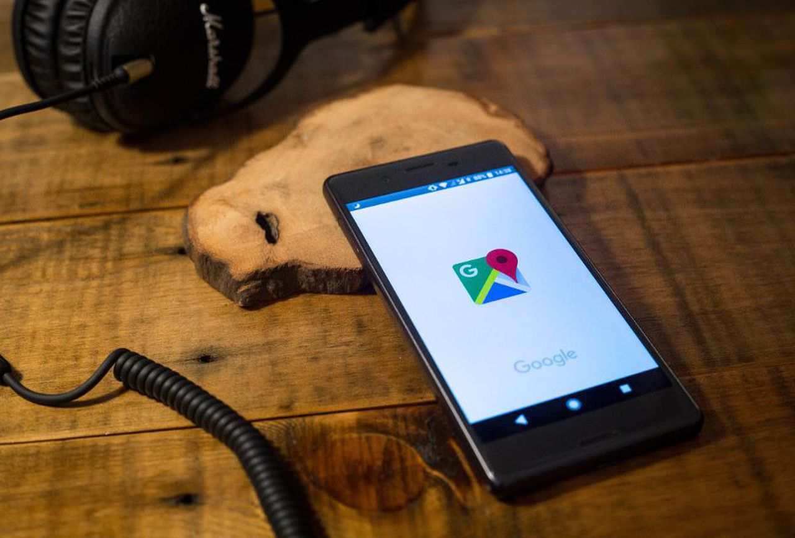
Solution
We have developed an application to trace the victim when ever the victim press the red button on our application the immediate pop up notification will be sent to the registered people around and to the near by cyber police station along with the live location.
ONE CLICK AWAY

Slide 6

ALL WE NEED IS …
RIGHTS
RESPECT
RESPONSIBILITY

Slide 7


